Slide 1

Commercial Bank Marketing Campaign
Jiangningzi Li
October 2022
Case study

Slide 2
Agenda
Part 1- Client Demographic
part 2- Results from the Last Campaign
part 3- Analyzing
Part 4- Discussion and Recommendation
part 5- Q & A

Slide 3
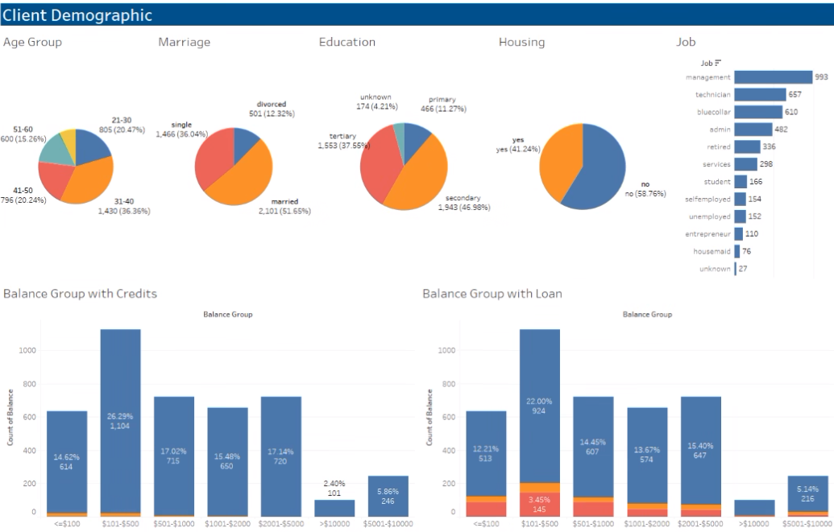
Part 1- Client Demographic
Notes:
The purpose of today's discussion is to share predicting insights of our potential client from the last campaign.
Before we dig into that, let's do a recap of the client demographic. Focusing group on Variable - y - has the client subscribed to a term deposit? ("yes","no")

Slide 4
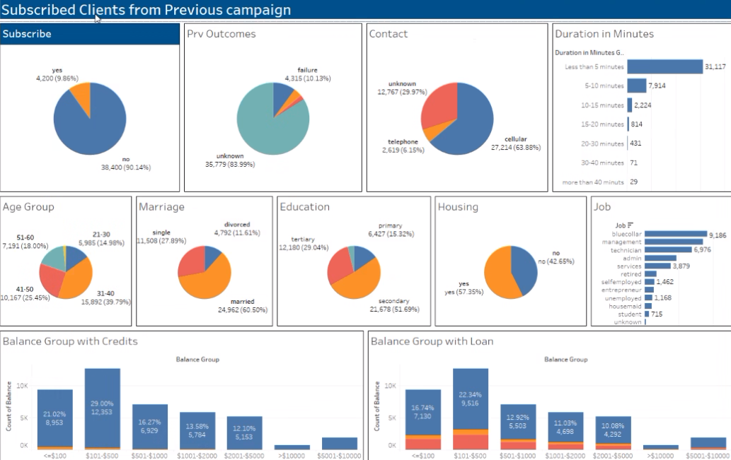
Results from the Last Campaign
Notes:
This is the outcome of the previous campaign
With a total of 42600 people.
There are about 10% subscribed to our products (term deposit).
Since our discussion purpose is to look into the factors that encourage people to subscribe to our products.
For the rest of the discussion, we will be focusing on the 4200 subscribers.

Slide 5
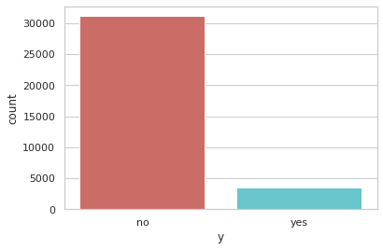
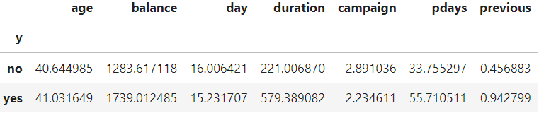
Models On Python
Notes:
From the following analyzing result, it is clearly shown that 1- Age range for subscribers are higher than non-subscribers.
2- Bank statement Balances of subscribers are higher than non-subscribers.
3- Subscribers contacts about 1-day fasters than non-subscribers.
4- The average duration of the last contact is 2.6 times higher in the subscription group.
Interestingly, on the other hand, the number of days that passed after the last contact with the client, from a previous campaign is smaller 1- Average days of users who purchased financial products (days since last contacted the customer)
2- The campaign should be less than the average days of non-purchasing users, which is reasonable because the smaller the pdays
3- The closer the day of the last call, the stronger the user's memory of financial products, and therefore the greater the chance of sales.
4- If the average campaign of users who purchase financial products (the number of phone calls with users) 5- Similarly, the average campaign of users who have not purchased.

Slide 6
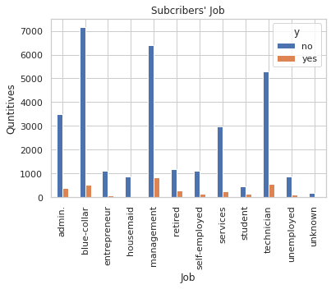
Models On Python
Notes:
Relative to Job Variables for the conclusion:
1- It is clear to see that the number of term deposits is varies by work.
2- Management is the top buyer, but the non-subscribers are ranking second.
3- Numbers in blue-collar, admin are relatively large.

Slide 7
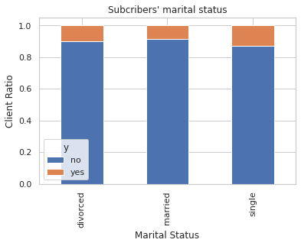
Models On Python
Notes:
1- Marital status doesn't show strong relative to subscribers' preference.
2- Single/Divorced people are more likely to make a term deposit.

Slide 8
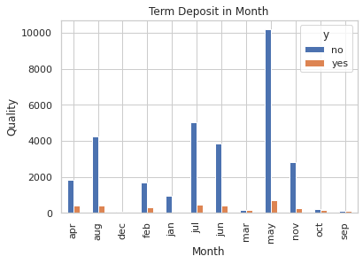
Models On Python
Notes:
During the holiday season, December, it is unlikely for people to make a term deposit.

Slide 9
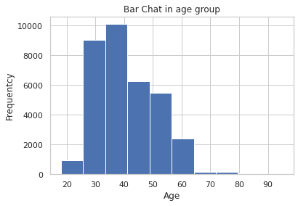
Models On Python

Slide 10
Models On R
Download files on: https://github.com/lydiayes/Cemmercial-Bank-Marketing-Campaign
1- Using Random Forest Model for the machine learning algorithm.
2- Combing the 17 variables decision trees.
3- Evaluate the total trees for taking a majority vote.
4- The greater the trees in the random Forest Model
the more actually the prediction will be.

Slide 11
Random Forest

Slide 12
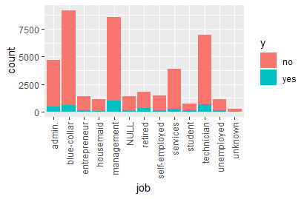
Part 4- Recommendation
Notes:
***There is a certain opportunity for management and technician clients.
People have the potential willing to subscribe
People who have cell phone contact number

Slide 13
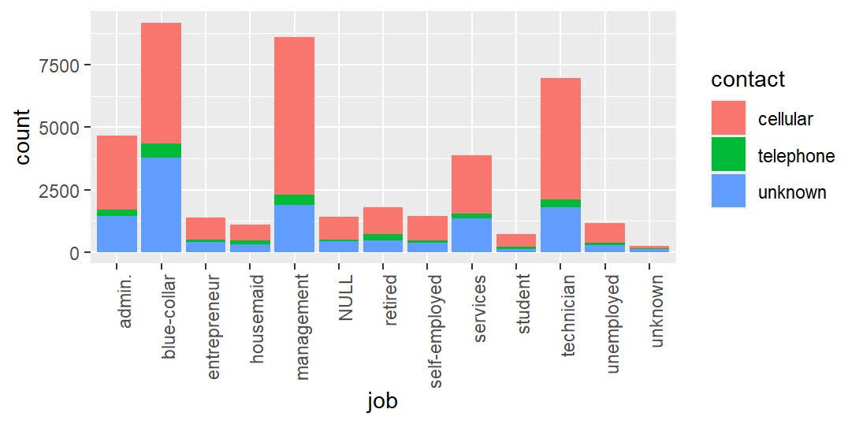
Part 4- Recommendation
Notes:
***There is a huge opportunity for management and technician, who has the potential willing to subscribe and has cell-phone.
People in the management and technician industry.
People have the potential willing to subscribe
People who have cell phone contact number

Slide 14
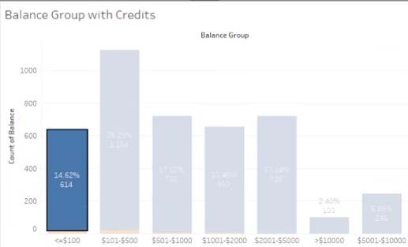
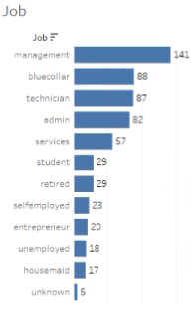
Part 4- Recommendation
Notes:
***With bigger pictures in strategy
we are not only going to focus on the client who has a lot of balance in our current deposit account.
People with low balances in the bank, but work in the management and technology industry might have more bank accounts than one.
For the business strategy, people who have less than 100 dollars in the bank account are actually in the management industry.
This means people have high incomes that might have the possibility to own several bank accounts.
We will try to contact people who have less balance in their bank account to transfer their term deposits from another bank to our bank.

Slide 15
Part 5 Q&A
Thank you! lijiangningzi@gmail.com

